Slide 1
PAS10 CA Property Conversions
Regression Test Plan
October 5th, 2016

Slide 2
High level Summary of Regression testing for CA Homeowner Conversions (Standard Regression)
As per PAS10 scope, below are the major Additions and Enhancements to Regression testing for CA Property Homeowners Conversions which mainly contains HO3,HO4 and HO6 products
New Conversion Specific functionalities (Applicable to converted policies)
Forms specific to converted policies implemented (Renewal Reminder - Home Banking, Pre renewal form etc.)
Enhancements to Generic functionalities (Applicable to both organic and converted policies)
Existing CA eligibility rules modified
Existing CA property forms retired and replaced with new forms
Coverage limits are altered

Slide 3
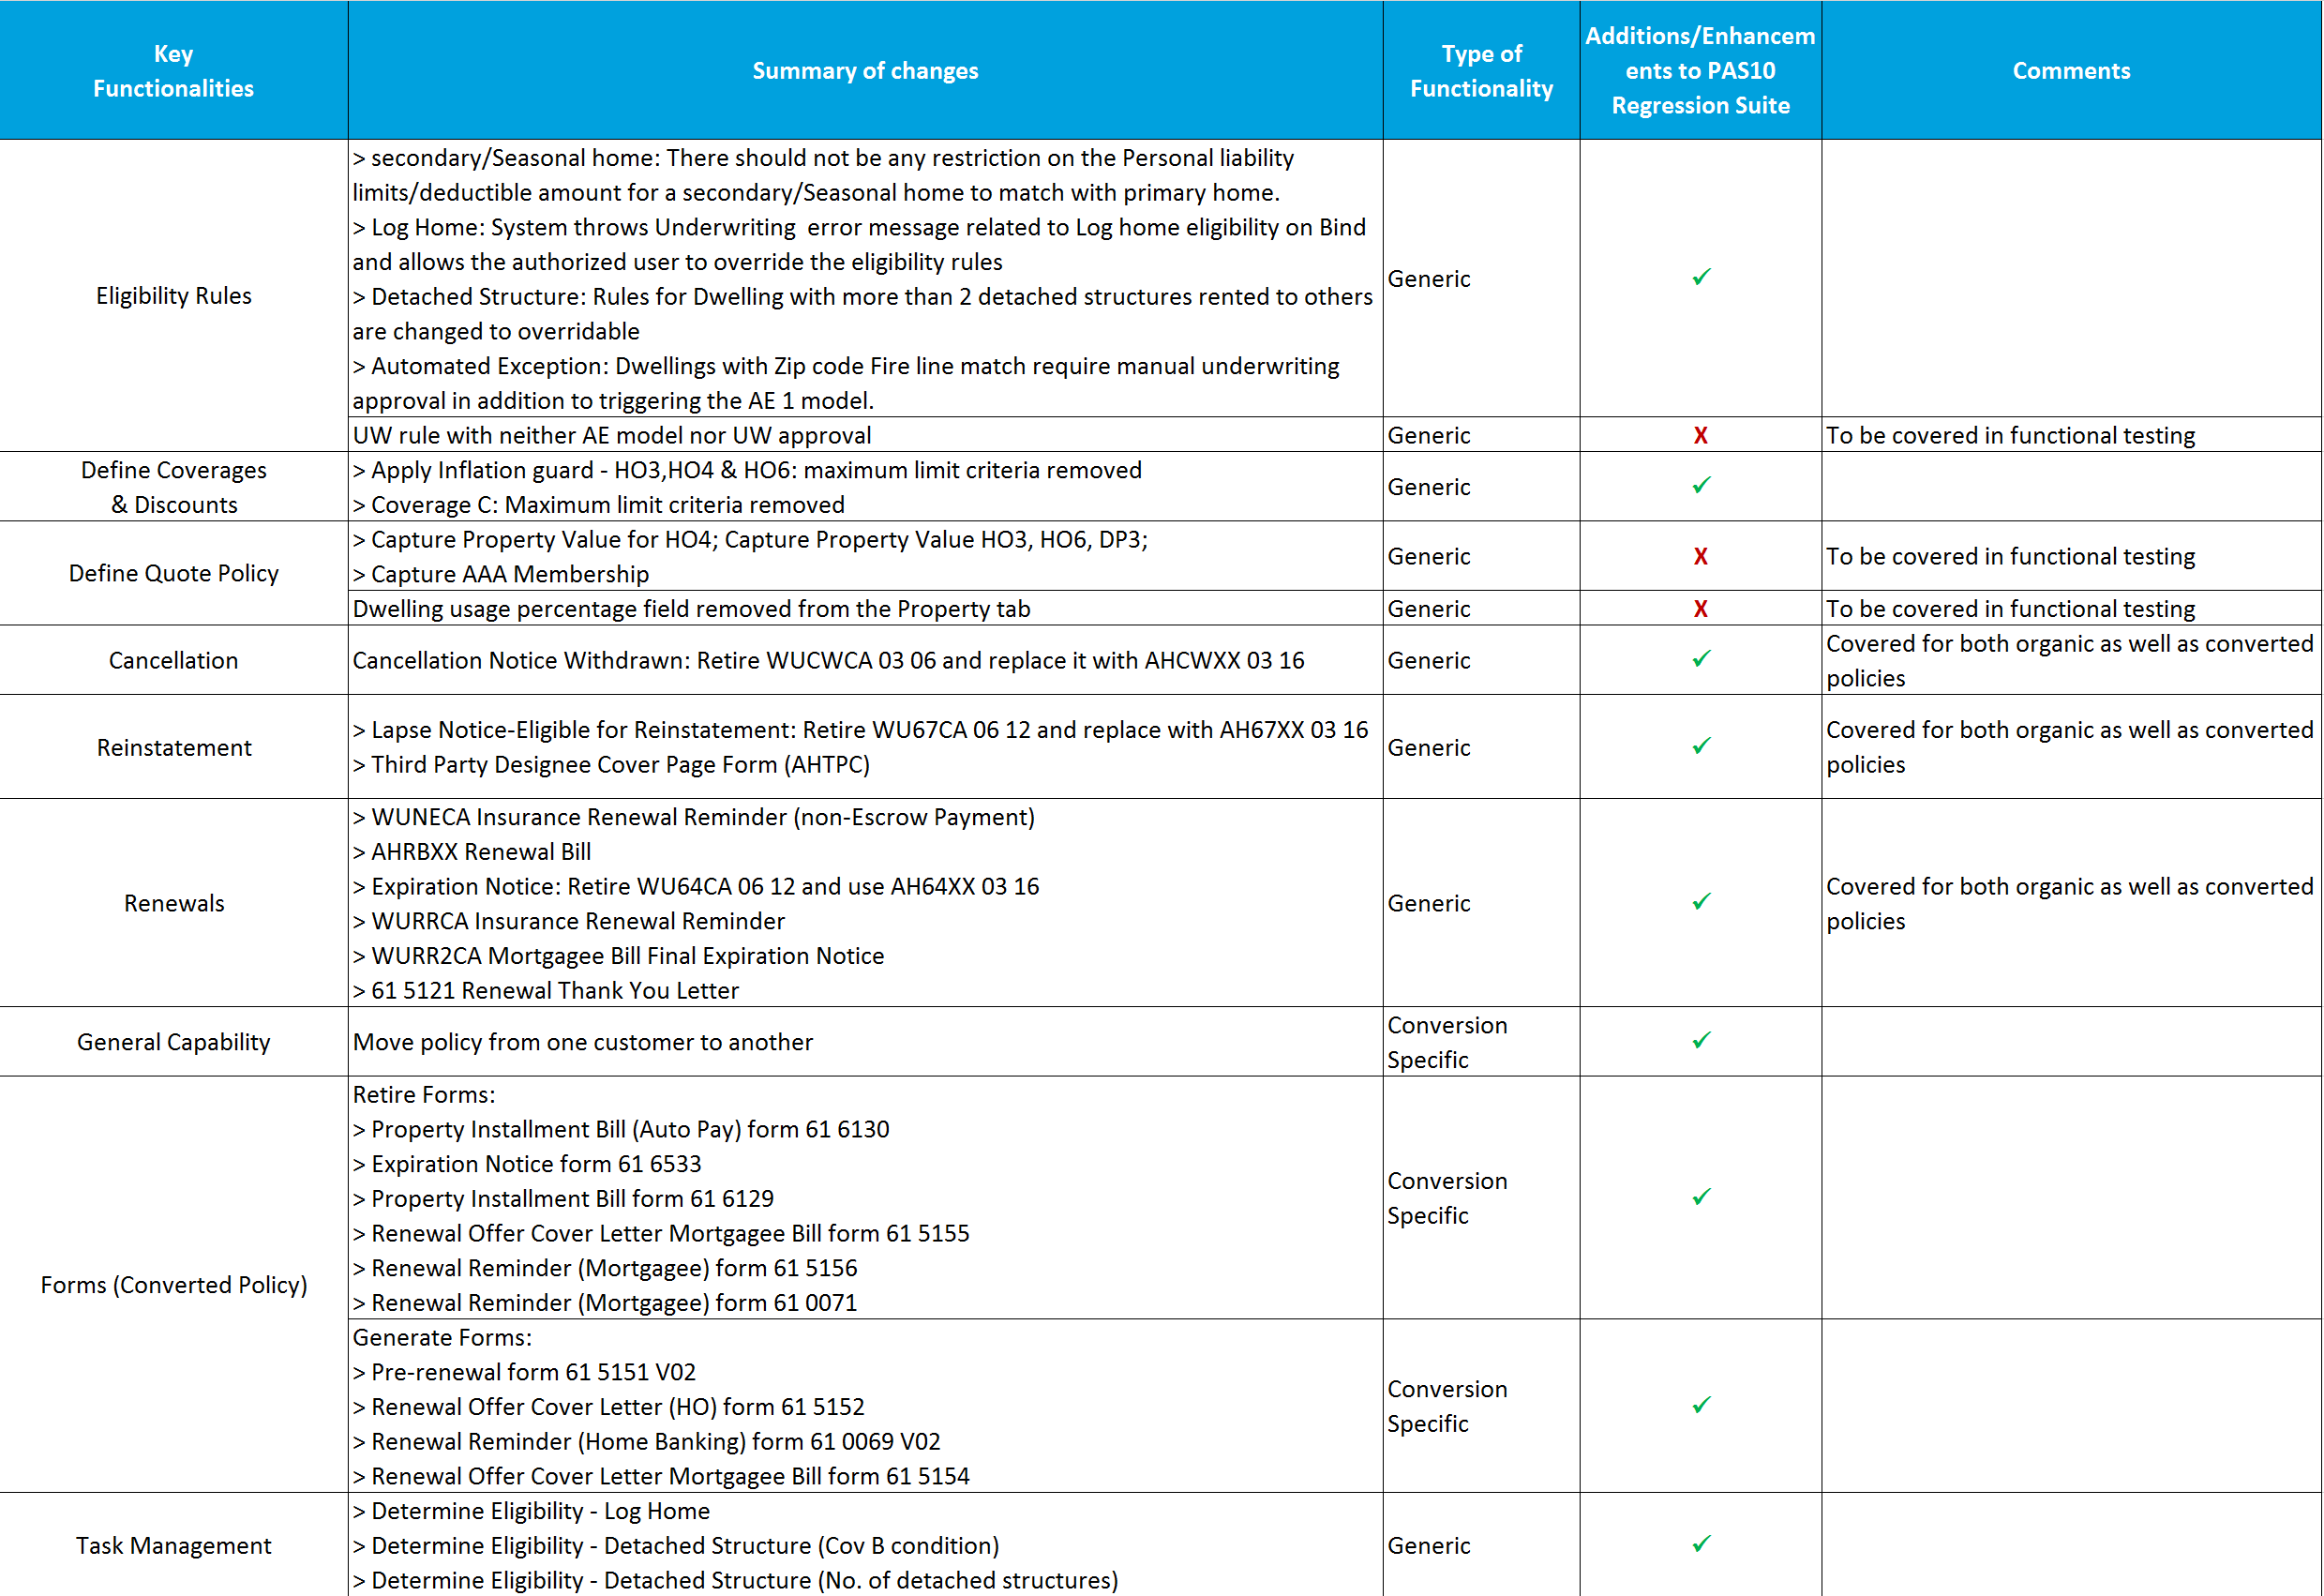
Regression testing Scope Summary of CA Homeowners Conversions

Slide 4
Homeowners Conversion Illustrative Scenario
CA Homeowners scenario will cover various functionalities from conversion timeline (R-58 to R) till 2nd Renewal of policy in PAS (2R).
Following diagram depicts a scenario which covers conversion specific functionalities during conversion timeline, followed by generic functionalities once policy is converted into PAS.
Conversion Specific Functionality
Generic Functionality
Conversion Renewal
(R-58)
Conversion Renewal
(R-48)
Conversion Renewal
(R-10)
Conversion Renewal (R+1)
Midterm Changes/Cancellation/Reinstatement/Rewrite
Renewal
(2R)
BILLING
PRIVILEGE AND TASK MANAGEMENT
Policy is imported from HDES legacy to PAS
Converted policy Active in PAS
Cancellation Notice
Non Pay Cancel
Lapse Notice
Reinstatement W/O Lapse
Renewal offer cover letter for converted policy –Insured / Mortgagee Bill
Renewal Reminder (Home Banking) form 61 0069 for converted policy
Renewal Offer Cover Letter Mortgagee Bill
Renewal Status
Membership validation at renewal
Change payment on current term of policy
Renewal Bill
Automatic renewal with lapse

Slide 5
High level Summary of CA SIS/Foxpro Conversions (Standard Regression)
Following major functionalities are implemented as part of CA Property conversions from SIS and Foxpro, which mainly contain DP3 and PUP products respectively.
New functionalities (Applicable to converted policies)
Premium Variance rules
Prior term balance transfer
Operational reports
Generation of forms for converted policies
Suppression of forms for converted policies

Slide 6
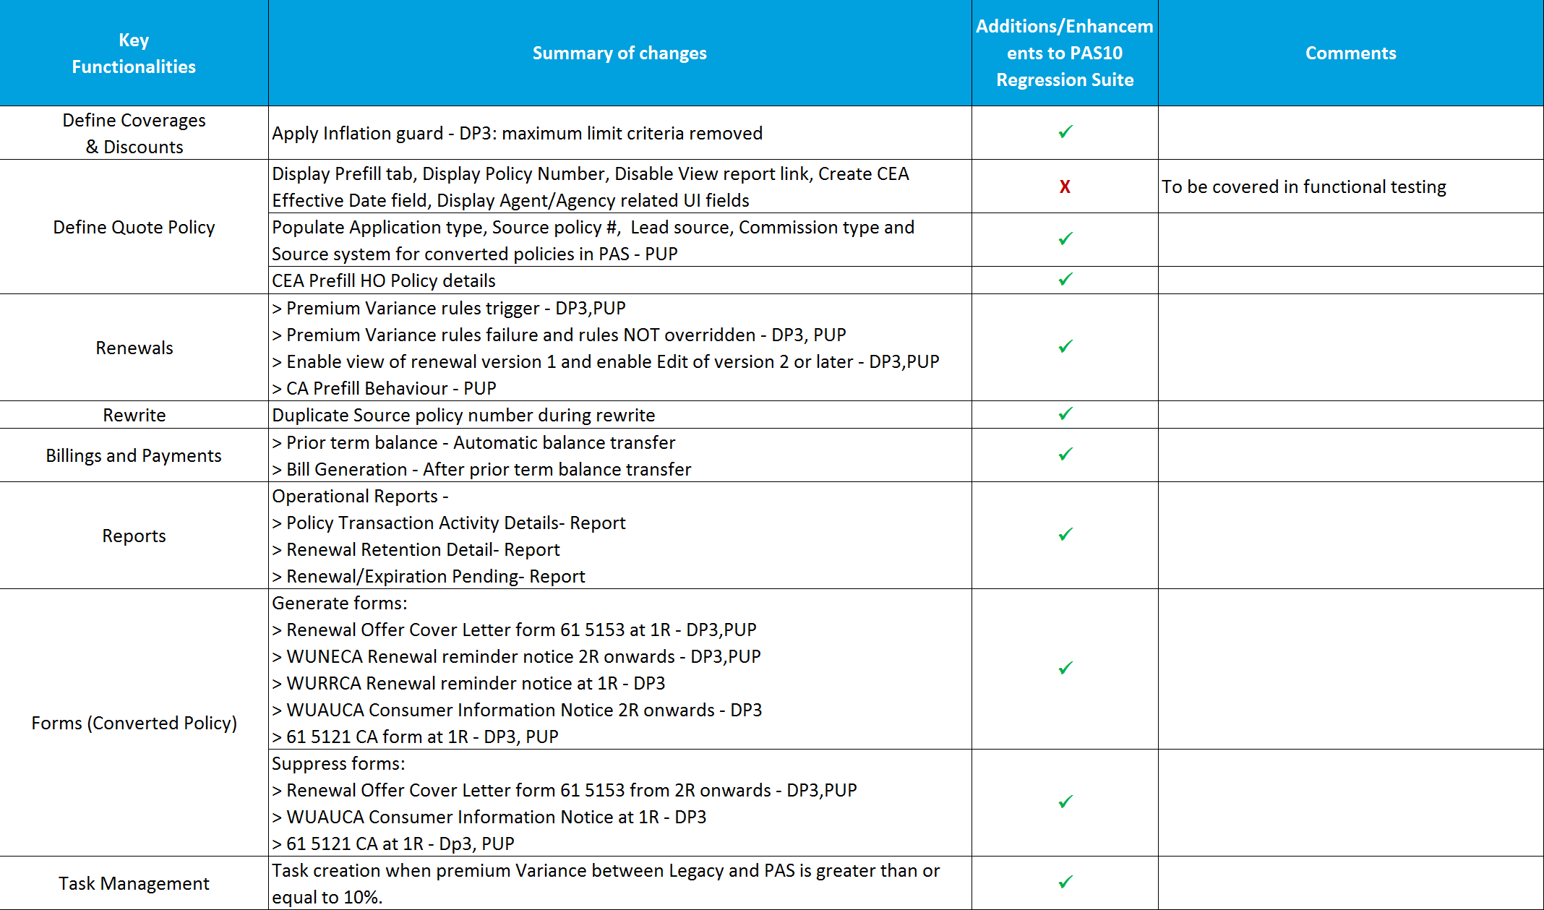
Release Scope Summary of CA SIS/Foxpro Conversions

Slide 7
High Level Summary of CA Conversions - CFT
As per PAS10 scope, below are the major Additions and Enhancements to CFT
CFT feed files validation for in-scope HDES test scenarios
Validation of general ledger and sub ledger entries
CFT feed files validation for in-scope SIS test scenarios
Validation of general ledger and sub ledger entries
CFT feed files validation for in-scope FoxPro test scenarios
Validation of general ledger and sub ledger entries

Slide 8
High Level Summary of CA Conversions - Integration
Based on the priority of an interface, impact of conversion on it and current regression timelines, 13 interfaces have been categorized as ‘In Scope’ for PAS 10 regression testing for converted policies.
5 of 13 (in green) will be validated by system owners and 8 (in grey) require file or system validations.
# | Integration Point | Product and state details | Coverage/Validations | Time to signoff | Point of Contact
1 | Enterprise Commissions | HDES CA HO, SIS CA DP3 and FoxPro CA PUP | Commissions feed 4216,4217,4218 | 2 weeks | Jason Hug
2 | IVANS | HDES CA HO, SIS CA DP3 and FoxPro CA PUP | NCNU and AZ files | 4 - 2 weeks | Sean Lucero
3 | LexisNexis | HDES CA HO, SIS CA DP3 and FoxPro CA PUP | Insurance score-R,2R,3R,CLUE Reports, Current Carrier | 1 week | Sean Lucero
4 | CIS | HDES CA HO, SIS CA DP3 and FoxPro CA PUP | 3102 inspection file and PLCY_INSPCTN_ORDR OPS table | 1 week | Sean Lucero
5 | Payment Central | HDES CA HO, SIS CA DP3 and FoxPro CA PUP | BOACheckReconciliationfile, 7001-Payment methods, NCO collection file, Bill due file ,Recurring request and response file, Payment reject and PCNSF un-enroll feed file, Remittance Feed file, enrollment & un-enrollment before and alter bill generation | 1-4-6 weeks phased signoff plan | Usha Krishnan
6 | Membership – (AAA National/CDX) | HDES CA HO, SIS CA DP3 and FoxPro CA PUP | No Membership, Renewals-4004 and 3004 file | NA
7 | Anti Redlining | HDES CA HO, SIS CA DP3 and FoxPro CA PUP | 4037 file | NA
8 | Blue cod | HDES CA HO, SIS CA DP3 and FoxPro CA PUP | 3075 file | NA
9 | CAS | HDES CA HO, SIS CA DP3 and FoxPro CA PUP | Policy retrieval and claim loss summary | NA
10 | MDM | HDES CA HO, SIS CA DP3 and FoxPro CA PUP | Retrievecustomer, recordcustomer and findcustomer | NA
11 | NCNU Commissions | HDES CA HO, SIS CA DP3 and FoxPro CA PUP | Commissions feed 4002,4006,4018 | NA
12 | ISO – 360, PPC and Fireline | HDES CA HO, SIS CA DP3 and FoxPro CA PUP | UW rules, Error status, Task generation, service down, PPC reorder at 2R, | NA
13 | Net Promoter Score NPS | HDES CA HO, SIS CA DP3 and FoxPro CA PUP | 4020 file | NA
14 | SOA Services | HDES CA HO, SIS CA DP3 and FoxPro CA PUP | Retrieveautopolicydetails and Retrievepropertypolicydetails | NA

Slide 9
High Level Summary of CA Conversions - HVT
For Packet Print Conversion testing, renewal packets would be generated for all three legacy system sources and submitted for review.
Each packet would comprise of 4 policies.
For CA HDES , once the policy is imported and a part of PAS, we would be generating packets for billing and cancellation on the policy as well, each packet comprising of 4 policies.
New Business packets are not in scope for conversion.
Product | New Business | Billing | Cancellation | Renewal | Total
CA HDES(HO) | 0 | 4 | 4 | 4 | 12
CA SIS(DP3) | 0 | 0 | 0 | 4 | 4
CA FoxPro(PUP) | 0 | 0 | 0 | 4 | 4
Total | 0 | 4 | 4 | 12 | 20

Slide 10
Appendix
To be added
<List of Conversion scenarios>
Sample Design

